Slide 1
Chapter 3 Objectives
The CCNA Topics Covered in this chapter include:
  What are Extended ACLs
  Configuration
  Example of extended ACL

Slide 2
Extended ACLs
Extended ACLs are used more often than standard ACLs because they provide a greater range of control.
Extended ACLs check the source and destination packet addresses as well as being able to check for protocols and port numbers.
At the end of the extended ACL statement, additional precision is gained from a field that specifies the optional Transmission Control Protocol (TCP) or User Datagram Protocol (UDP) port number.
Logical operations may be specified such as, equal (eq), not equal (neq), greater than (gt), and less than (lt), that the extended ACL will perform on specific protocols.
Extended ACLs use an access-list-number in the range 100 to 199 (also from 2000 to 2699 in recent IOS).

Slide 3
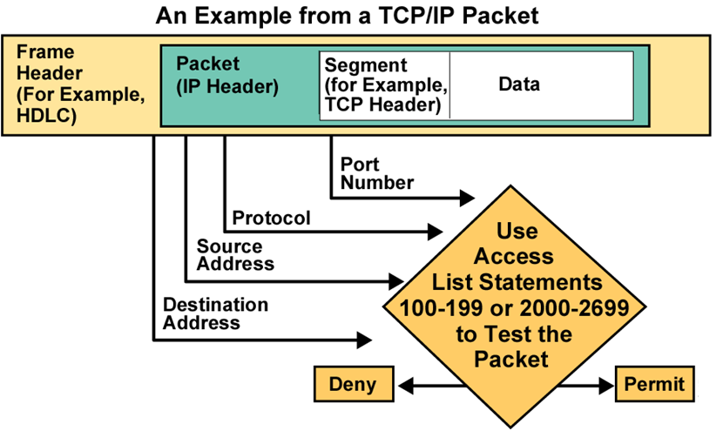
Testing Packets with Extended Access Lists

Slide 4

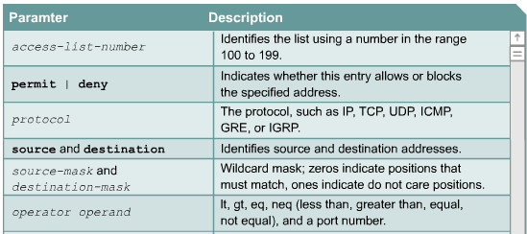
Extended ACL Syntax

Slide 5
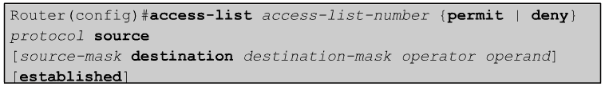
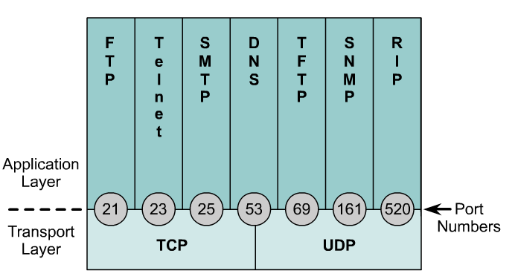
Extended Access Lists
Operator and operand can also refer to ICMP Types and Codes or whatever the protocol is being checked.
If the operator and operand follow the source address it refers to the source port
If the operator and operand follow the destination address it refers to the destination port.

Slide 6


Exercise – Extended Access List
Non 172.16.0.0
172.16.3.0
172.16.4.0
S0
E0
E1
Deny FTP traffic from subnet 172.16.4.0 to subnet 172.16.3.0 out of E0 and permit all other traffic
R(config)# access-list 101 deny tcp 172.16.4.0 0.0.0.255 172.16.3.0 0.0.0.255 eq 20
R(config)# access-list 101 deny tcp 172.16.4.0 0.0.0.255 172.16.3.0 0.0.0.255 eq 21
R(config)# access-list 101 permit any any (implicit deny all)
R(config)# interface E0
R(config-if)# ip access-group 101 out

Slide 7
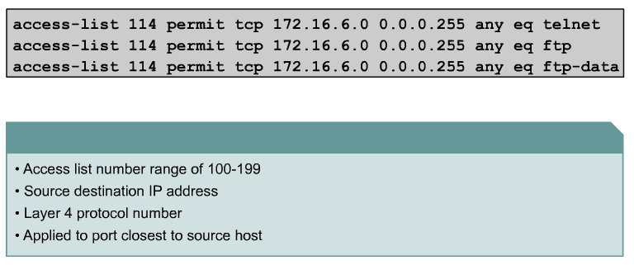
Extended Access Lists - Examples
port number or protocol name

Slide 8
Rules
For extended access list apply near to the source
For standard access list apply near to the destination

